Slide 1

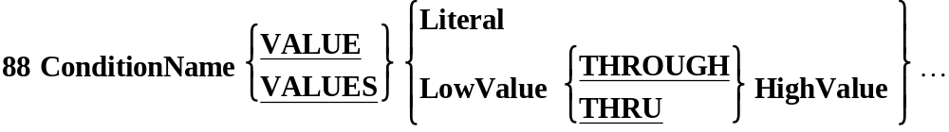
Condition Names.
Wherever a condition can occur, such as in an IF statement or an EVALUATE or a PERFORM..UNTIL, a CONDITION NAME (Level 88) may be used.
A Condition Name is essentially a BOOLEAN variable which is either TRUE or FALSE.

Slide 2
Defining Condition Names.
Condition Names are defined in the DATA DIVISION using the special level number 88.
They are always associated with a data item and are defined immediately after the definition of the data item.
A condition name takes the value TRUE or FALSE depending on the value in its associated data item.
A Condition Name may be associated with ANY data item whether it is a group or an elementary item.
The VALUE clause is used to identify the values which make the Condition Name TRUE.

Slide 3
01 CityCode PIC 9 VALUE 5.
88 Dublin VALUE 1.
88 Limerick VALUE 2.
88 Cork VALUE 3.
88 Galway VALUE 4.
88 Sligo VALUE 5.
88 Waterford VALUE 6.
88 UniversityCity VALUE 1 THRU 4.
IF Limerick
DISPLAY "Hey, we're home."
END-IF
IF UniversityCity
PERFORM CalcRentSurcharge
END-IF
City Code
2
Dublin FALSE
Limerick TRUE
Cork FALSE
Galway FALSE
Sligo FALSE
Waterford FALSE
UniversityCity TRUE

Slide 4
01 CityCode PIC 9 VALUE 5.
88 Dublin VALUE 1.
88 Limerick VALUE 2.
88 Cork VALUE 3.
88 Galway VALUE 4.
88 Sligo VALUE 5.
88 Waterford VALUE 6.
88 UniversityCity VALUE 1 THRU 4.
IF Limerick
DISPLAY "Hey, we're home."
END-IF
IF UniversityCity
PERFORM CalcRentSurcharge
END-IF
City Code
6
Dublin FALSE
Limerick FALSE
Cork FALSE
Galway FALSE
Sligo FALSE
Waterford TRUE
UniversityCity FALSE

Slide 5
01 InputChar PIC X.
88 Vowel VALUE "A","E","I","O","U".
88 Consonant VALUE "B" THRU "D", "F","G","H"
"J" THRU "N", "P" THRU "T"
"V" THRU "Z".
88 Digit VALUE "0" THRU "9".
88 LowerCase VALUE "a" THRU "z".
88 ValidChar VALUE "A" THRU "Z","0" THRU "9".
IF ValidChar
DISPLAY "Input OK."
END-IF
IF LowerCase
DISPLAY "Not Upper Case"
END-IF
IF Vowel
Display "Vowel entered."
END-IF
Input Char
E
Vowel TRUE
Consonant FALSE
Digit FALSE
LowerCase FALSE
ValidChar TRUE

Slide 6
01 InputChar PIC X.
88 Vowel VALUE "A","E","I","O","U".
88 Consonant VALUE "B" THRU "D", "F","G","H"
"J" THRU "N", "P" THRU "T"
"V" THRU "Z".
88 Digit VALUE "0" THRU "9".
88 LowerCase VALUE "a" THRU "z".
88 ValidChar VALUE "A" THRU "Z","0" THRU "9".
IF ValidChar
DISPLAY "Input OK."
END-IF
IF LowerCase
DISPLAY "Not Upper Case"
END-IF
IF Vowel
Display "Vowel entered."
END-IF
Input Char
4
Vowel FALSE
Consonant FALSE
Digit TRUE
LowerCase FALSE
ValidChar TRUE

Slide 7
01 InputChar PIC X.
88 Vowel VALUE "A","E","I","O","U".
88 Consonant VALUE "B" THRU "D", "F","G","H"
"J" THRU "N", "P" THRU "T"
"V" THRU "Z".
88 Digit VALUE "0" THRU "9".
88 LowerCase VALUE "a" THRU "z".
88 ValidChar VALUE "A" THRU "Z","0" THRU "9".
IF ValidChar
DISPLAY "Input OK."
END-IF
IF LowerCase
DISPLAY "Not Upper Case"
END-IF
IF Vowel
Display "Vowel entered."
END-IF
Input Char
g
Vowel FALSE
Consonant FALSE
Digit FALSE
LowerCase TRUE
ValidChar FALSE

Slide 8
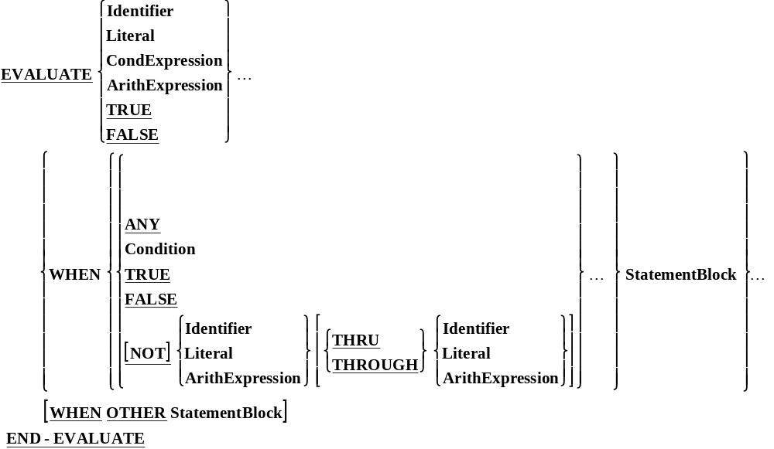
The Evaluate

Slide 9
Example - 1
EVALUATE TRUE
WHEN MONTH = 4 OR 6 OR 9 OR 11
MOVE 30 TO NO-OF-DAYS
WHEN MONTH = 2
MOVE 28 TO NO-OF-DAYS
WHEN OTHERS
MOVE 31 TO NO-OF-DAYS
END-EVALUATE.

Slide 10
Example - 2
EVALUATE MARKS
WHEN 80 THRU 100
MOVE “A” TO GRADE
WHEN 60 THRU 79
MOVE “B” TO GRADE
WHEN 45 THRU 59
MOVE “C” TO GRADE
WHEN 30 THRU 44
MOVE “D” TO GRADE
WHEN ZERO THRU 29
MOVE “E” TO GRADE
WHEN OTHERS
MOVE “W” TO GRADE
END-EVALUATE.
NOTE: “W” is moved in the case of wrong MARKS.

Slide 11
Redefines And Rename Clause

Slide 12
Redefines Clause
Sometimes it may be found that two or more storage areas defined in the data division are not in use simultaneously.In such cases only one storage area can serve the purpose of two or more areas if the area is redefined.
01 SALES-RECORD.
02 SALES-TYPE PIC X
02 SALES-BY-UNIT.
03 QTY PIC 9(4).
03 UNIT-PRICE PIC 9(8)V99.
02 TOTAL-SALES REDEFINES SALES-BY-UNIT.
03 AMOUNT PIC 9(10)V99.
03 FILLER PIC X(2).

Slide 13
LEVEL-NUMBER Data-Name-1 REDEFINES Data-Name-2
The level-number of Data-Name-1 And Data-Name-2 must be identical.
Except when the REDEFINES clause is used to 01 level, Data-Name-1 and Data-Name-2 must be of the same size.
The REDEFINES clause must immediately follow Data-Name-1.
The REDEFINES clause must not be used for Level-number 66 or 88 items.
The REDEFINES clause must not be used for records (01 level) describes in the FILE SECTION. The appearance of multiple 01 entries in the record description is implicitly assumed to be the redefinition of the first 01-level record.

Slide 14
Renames Clause
Sometimes a re-grouping of elementary data items in a record may be necessary so that they can belong to the original as well as to the new group. This is possible in COBOL by the use of the RENAMES clause.
01 PAY-REC..
03 FIXED-PAY.
05 BASIX PAY PIC 9(3)
05 DEARNESS-ALLOWANCE PIC 9(4)
03 ADDITIONAL-PAY.
05 HOUSE-RENT PIC 9(2)
05 MTHLY-INCENTIVE PIC 9(3)
03 DEDUCTIONS.
05 PF-DEDUCT PIC 9(3).
05 IT-DEDUCT PIC 9(3)
05 OTHER-DEDUCT PIC 9(3)
66 PAY-OTHER-THAN-BASIC RENAMES DEARNESS-ALLOWANCE THRU
MTHLY-INCENTIVE.
66 IT-AND-PF-DEDUCTIONS RENAMES PF-DEDUCT THRU IT-DEDUCT.

Slide 15
66 Data-Name-1 RENAMES Data-Name-2 THRU Data-Name-3
All RENAMES entries must be written only after the last record description entry.
Data-Name-2 and Data-Name-3 can be the names of elementary items or group items. They, however. Cannot be items of Level 01,66,77 or 88.
Neither Data-Name-2 nor Data-Name-3 can have an OCCURS clause in its description entry .
Data-Name-3, if mentioned must fallow Data-Name-2 in the record and must not be one of its sub fields.

Slide 16
The
PERFORM

Slide 17
The PERFORM Verb
Iteration is an important programming construct. We use iteration when we need to repeat the same instructions over and over again.
Most programming languages have several iteration keywords (e.g. WHILE, FOR, REPEAT) which facilitate the creation different ‘types’ of iteration structure.
COBOL only has one iteration construct; PERFORM.
But the PERFORM has several variations.
Each variation is equivalent to one of the iteration ‘types’ available in other languages.

Slide 18
Run of PerformFormat1
In TopLevel. Starting to run program
>>>> Now in OneLevelDown
>>>>>>>> Now in TwoLevelsDown.
>>>> Back in OneLevelDown
Back in TopLevel.
PROCEDURE DIVISION.
TopLevel.
DISPLAY "In TopLevel. Starting to run program"
PERFORM OneLevelDown
DISPLAY "Back in TopLevel.".
STOP RUN.
TwoLevelsDown.
DISPLAY ">>>>>>>> Now in TwoLevelsDown."
OneLevelDown.
DISPLAY ">>>> Now in OneLevelDown"
PERFORM TwoLevelsDown
DISPLAY ">>>> Back in OneLevelDown".

Slide 19
Run of PerformFormat1
In TopLevel. Starting to run program
>>>> Now in OneLevelDown
>>>>>>>> Now in TwoLevelsDown.
>>>> Back in OneLevelDown
Back in TopLevel.
PROCEDURE DIVISION.
TopLevel.
DISPLAY "In TopLevel. Starting to run program"
PERFORM OneLevelDown
DISPLAY "Back in TopLevel.".
STOP RUN.
TwoLevelsDown.
DISPLAY ">>>>>>>> Now in TwoLevelsDown."
OneLevelDown.
DISPLAY ">>>> Now in OneLevelDown"
PERFORM TwoLevelsDown
DISPLAY ">>>> Back in OneLevelDown".

Slide 20
Run of PerformFormat1
In TopLevel. Starting to run program
>>>> Now in OneLevelDown
>>>>>>>> Now in TwoLevelsDown.
>>>> Back in OneLevelDown
Back in TopLevel.
PROCEDURE DIVISION.
TopLevel.
DISPLAY "In TopLevel. Starting to run program"
PERFORM OneLevelDown
DISPLAY "Back in TopLevel.".
STOP RUN.
TwoLevelsDown.
DISPLAY ">>>>>>>> Now in TwoLevelsDown."
OneLevelDown.
DISPLAY ">>>> Now in OneLevelDown"
PERFORM TwoLevelsDown
DISPLAY ">>>> Back in OneLevelDown".

Slide 21
Run of PerformFormat1
In TopLevel. Starting to run program
>>>> Now in OneLevelDown
>>>>>>>> Now in TwoLevelsDown.
>>>> Back in OneLevelDown
Back in TopLevel.
PROCEDURE DIVISION.
TopLevel.
DISPLAY "In TopLevel. Starting to run program"
PERFORM OneLevelDown
DISPLAY "Back in TopLevel.".
STOP RUN.
TwoLevelsDown.
DISPLAY ">>>>>>>> Now in TwoLevelsDown."
OneLevelDown.
DISPLAY ">>>> Now in OneLevelDown"
PERFORM TwoLevelsDown
DISPLAY ">>>> Back in OneLevelDown".

Slide 22
Run of PerformFormat1
In TopLevel. Starting to run program
>>>> Now in OneLevelDown
>>>>>>>> Now in TwoLevelsDown.
>>>> Back in OneLevelDown
Back in TopLevel.
PROCEDURE DIVISION.
TopLevel.
DISPLAY "In TopLevel. Starting to run program"
PERFORM OneLevelDown
DISPLAY "Back in TopLevel.".
STOP RUN.
TwoLevelsDown.
DISPLAY ">>>>>>>> Now in TwoLevelsDown."
OneLevelDown.
DISPLAY ">>>> Now in OneLevelDown"
PERFORM TwoLevelsDown
DISPLAY ">>>> Back in OneLevelDown".

Slide 23
Run of PerformFormat1
In TopLevel. Starting to run program
>>>> Now in OneLevelDown
>>>>>>>> Now in TwoLevelsDown.
>>>> Back in OneLevelDown
Back in TopLevel.
PROCEDURE DIVISION.
TopLevel.
DISPLAY "In TopLevel. Starting to run program"
PERFORM OneLevelDown
DISPLAY "Back in TopLevel.".
STOP RUN.
TwoLevelsDown.
DISPLAY ">>>>>>>> Now in TwoLevelsDown."
OneLevelDown.
DISPLAY ">>>> Now in OneLevelDown"
PERFORM TwoLevelsDown
DISPLAY ">>>> Back in OneLevelDown".

Slide 24
Run of PerformFormat1
In TopLevel. Starting to run program
>>>> Now in OneLevelDown
>>>>>>>> Now in TwoLevelsDown.
>>>> Back in OneLevelDown
Back in TopLevel.
PROCEDURE DIVISION.
TopLevel.
DISPLAY "In TopLevel. Starting to run program"
PERFORM OneLevelDown
DISPLAY "Back in TopLevel.".
STOP RUN.
TwoLevelsDown.
DISPLAY ">>>>>>>> Now in TwoLevelsDown."
OneLevelDown.
DISPLAY ">>>> Now in OneLevelDown"
PERFORM TwoLevelsDown
DISPLAY ">>>> Back in OneLevelDown".

Slide 25
Run of PerformFormat1
In TopLevel. Starting to run program
>>>> Now in OneLevelDown
>>>>>>>> Now in TwoLevelsDown.
>>>> Back in OneLevelDown
Back in TopLevel.
PROCEDURE DIVISION.
TopLevel.
DISPLAY "In TopLevel. Starting to run program"
PERFORM OneLevelDown
DISPLAY "Back in TopLevel.".
STOP RUN.
TwoLevelsDown.
DISPLAY ">>>>>>>> Now in TwoLevelsDown."
OneLevelDown.
DISPLAY ">>>> Now in OneLevelDown"
PERFORM TwoLevelsDown
DISPLAY ">>>> Back in OneLevelDown".

Slide 26
Go To Statement
The GO TO statement transfers control from one part of the Procedure Division to another. The types of GO TO statements are:
    Unconditional
    Conditional
GO TO SumSalesExit.
GO TO CASE-ONE DEPENDING ON ACCOUNT-TYPE.
EXIT Statement
The EXIT verb indicates a no operation, and when executed, no action takes place.
SumSalesExit.
EXIT.

Slide 27
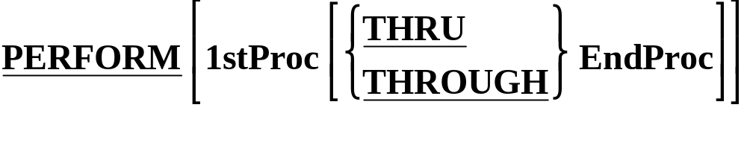
Perform with Thru option
This is the only type of PERFORM that is not an iteration construct.
It instructs the computer to transfer control to an out-of-line block of code.
When the end of the block is reached, control reverts to the statement (not the sentence) immediately following the PERFORM.
1stProc and EndProc are the names of Paragraphs or Sections.
The PERFORM..THRU instructs the computer to treat the Paragraphs or Sections from 1stProc TO EndProc as a single block of code.

Slide 28
Go To and Perform with Thru option
PROCEDURE DIVISION
Begin.
PERFORM SumSales THRU SumSalesExit
STOP RUN.
SumSales.
Statements
Statements
IF ErrorFound GO TO SumSalesExit
END-IF
Statements
Statements
Statements
IF ErrorFound GO TO SumSalesExit
END-IF
Statements
SumSalesExit.
EXIT.

Slide 29
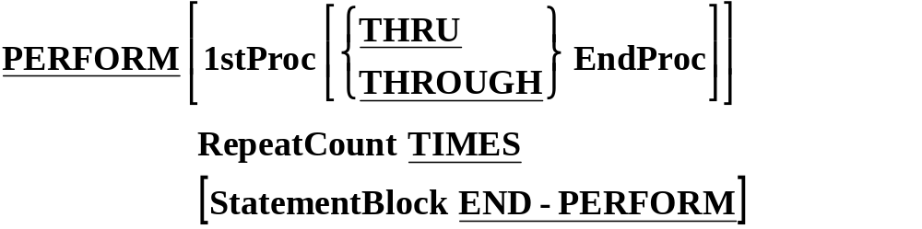
Perform with Times option
PROCEDURE DIVISION.
Begin.
DisplayName.
Statements
PERFORM DisplayName 4 TIMES
Statements
STOP RUN.
DISPLAY “ Sudharshana ”.

Slide 30
In Line Perform option
Run of PerformExample2
$ SET SOURCEFORMAT"FREE"
IDENTIFICATION DIVISION.
PROGRAM-ID. PerformExample2.
AUTHOR. Michael Coughlan.
DATA DIVISION.
WORKING-STORAGE SECTION.
01 NumofTimes PIC 9 VALUE 5.
PROCEDURE DIVISION.
Begin.
DISPLAY "Starting to run program"
PERFORM 3 TIMES
DISPLAY ">>>>This is an in line Perform"
END-PERFORM
DISPLAY "Finished in line Perform"
PERFORM OutOfLineEG NumOfTimes TIMES
DISPLAY "Back in Begin. About to Stop".
STOP RUN.
OutOfLineEG.
DISPLAY ">>>> This is an out of line Perform".
Starting to run program
>>>>This is an in line Perform
>>>>This is an in line Perform
>>>>This is an in line Perform
Finished in line Perform
>>>> This is an out of line Perform
>>>> This is an out of line Perform
>>>> This is an out of line Perform
>>>> This is an out of line Perform
>>>> This is an out of line Perform
Back in Begin. About to Stop

Slide 31
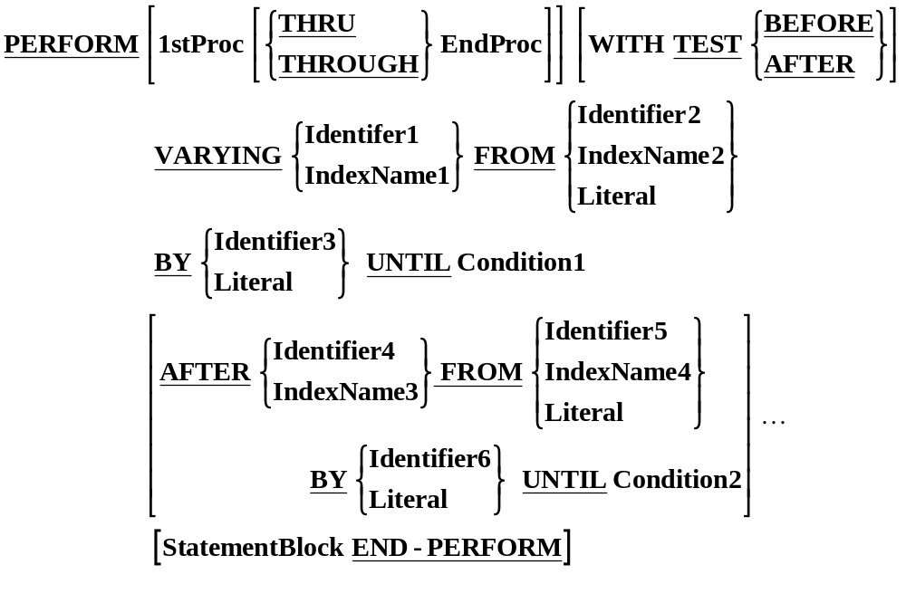
PERFORM..VARYING Syntax

Slide 32
Perform with Until option
MOVE ZERO TO SUM, NUMB.
PERFORM ADD-PARA UNTIL NUMB = 50.
ADD-PARA.
ADD 1 TO NUMB, ADD NUMB TO SUM.
Perform with Varying option
MOVE ZERO TO SUM, NUMB.
PERFORM ADD-PARA VARYING NUMB
FROM 1 BY 1 UNTIL NUMB > 10.
ADD-PARA.
ADD NUMB TO SUM.
Perform with Varying- After option
PERFORM RANGE-TO-BE-EXECUTED
VARYING I FROM 1 BY 1 UNTIL I > 20
AFTER J FROM 1 BY 1 UNTIL J > 10.

Slide 33
PERFORM VARYING Idx1 FROM 1 BY 1 UNTIL
Idx1 EQUAL TO 3
DISPLAY Idx1
END-PERFORM.
Idx1
1
Move 1 to Idx1
Idx1 = 3
True
Next Statement
False
Loop Body
Inc Idx1

Slide 34
PERFORM VARYING Idx1 FROM 1 BY 1 UNTIL
Idx1 EQUAL TO 3
DISPLAY Idx1
END-PERFORM.
Idx1
1
Move 1 to Idx1
Idx1 = 3
True
Next Statement
False
Loop Body
Inc Idx1

Slide 35
PERFORM VARYING Idx1 FROM 1 BY 1 UNTIL
Idx1 EQUAL TO 3
DISPLAY Idx1
END-PERFORM.
Idx1
1
Move 1 to Idx1
Idx1 = 3
True
Next Statement
False
1
Loop Body
Inc Idx1

Slide 36
PERFORM VARYING Idx1 FROM 1 BY 1 UNTIL
Idx1 EQUAL TO 3
DISPLAY Idx1
END-PERFORM.
Idx1
2
Move 1 to Idx1
Idx1 = 3
True
Next Statement
False
1
Loop Body
Inc Idx1

Slide 37
PERFORM VARYING Idx1 FROM 1 BY 1 UNTIL
Idx1 EQUAL TO 3
DISPLAY Idx1
END-PERFORM.
Idx1
2
Move 1 to Idx1
Idx1 = 3
True
Next Statement
False
1
Loop Body
Inc Idx1

Slide 38
PERFORM VARYING Idx1 FROM 1 BY 1 UNTIL
Idx1 EQUAL TO 3
DISPLAY Idx1
END-PERFORM.
Idx1
2
Move 1 to Idx1
Idx1 = 3
True
Next Statement
False
1
2
Loop Body
Inc Idx1

Slide 39
PERFORM VARYING Idx1 FROM 1 BY 1 UNTIL
Idx1 EQUAL TO 3
DISPLAY Idx1
END-PERFORM.
Idx1
3
Move 1 to Idx1
Idx1 = 3
True
Next Statement
False
1
2
Loop Body
Inc Idx1

Slide 40
PERFORM VARYING Idx1 FROM 1 BY 1 UNTIL
Idx1 EQUAL TO 3
DISPLAY Idx1
END-PERFORM.
Idx1
3
Move 1 to Idx1
Idx1 = 3
True
Next Statement
Exit value = 3
Next Statement
False
1
2
Loop Body
Inc Idx1

Slide 41
PERFORM IterationCount VARYING Idx1 FROM 1 BY 2
UNTIL Idx1 EQUAL TO 5
AFTER Idx2 FROM 6 BY -1
UNTIL Idx2 LESS THAN 4
Move 1 to Idx1
Move 6 to Idx2
T Idx1 Idx2
1 1 6
2 1 5
3 1 4
4 3 6
5 3 5
6 3 4
x = 5 = 6
Idx1 = 5
Y
Next Statement
N
Idx2 < 4
Y
N
IterationCount
Move 6 to Idx2
Inc Idx1
Dec Idx2

